Slide 1



PROSTRIKE GEAR
PRESENTED BY
Swarup Dahal

Slide 2
Table of Content
Introduction
Seqeunce Diagram
Activity Diagram
Problem Statement
Gantt Chart
Objectives
Expected Outcome
Methodology
Conclusion
References
Technologies Required
Use Case Diagram
Class Diagram
2

Slide 3

Introduction
Online shopping is rising with digital advancements, but areas like sports accessories face issues like irrelevant suggestions and poor categorization.
This project aims to build a dedicated e-commerce platform for buying and selling sports accessories i.e. for mainly football and cricket and some other products too.
It uses recommendation algorithms like cosine similarity to personalize user experience based on past behavior.
The platform targets athletes, fitness pros, hobbyists, students, and retailers with tailored product suggestions like bats, boots, jersy, cricket kits.
3

Slide 4
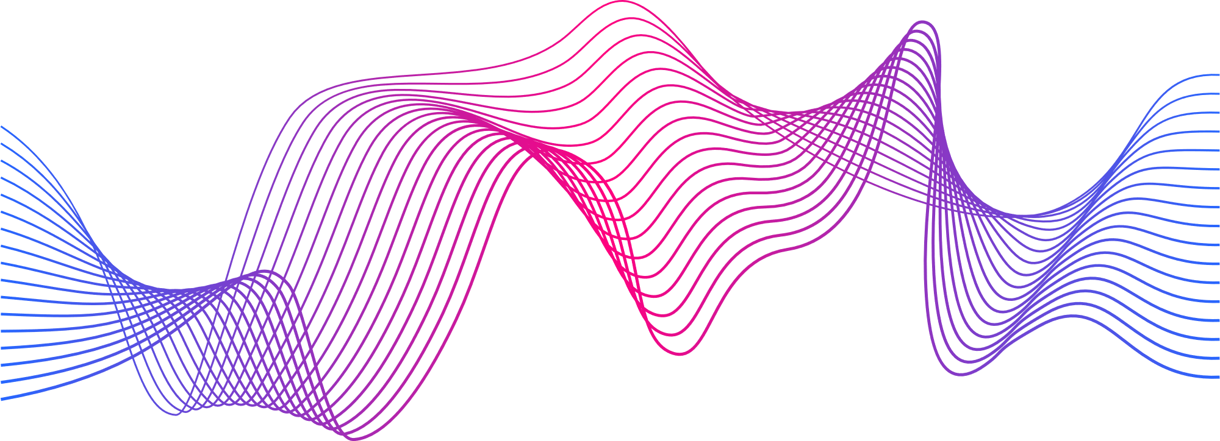
Problem Statement
Most e-commerce sites don’t really cater to sports lovers.
It’s hard to find what you’re looking for because recommendations aren’t personalized and items aren’t well-organized.
Deliver personalized product suggestions is difficult to recommend.
4

Slide 5

Objectives
·To build a responsive and secure web platform for sports products using HTML, CSS, JS, Python, and Django.
·To integrate a TF-IDF VECTORIZER and cosine similarity-based recommendation system.
·To implement full CRUD operations for users and products.
5

Slide 6
Methodology
Requirement Analysis
System Design
Implementation
Testing
Deployment
Maintenance
Gathering system requirements like customer roles, products details etc.
Designing the database schema, backend routes, and frontend UI layouts.
Using the HTML, CSS, JS, Python(Flask Framework) for code implementation
Conducting unit testing, and system testing.
Initially running locally.
Post-deployment fixes, upgrades, and possibly integrating AI features (like fraud detection).
6

Slide 7
Technologies Required
Frontend Tools | HTML, CSS JAVASCRIPT
Backend Tools | Python(Flask Framework)
Code Editor | VS Code
Version Control | Git and GitHub
7

Slide 8
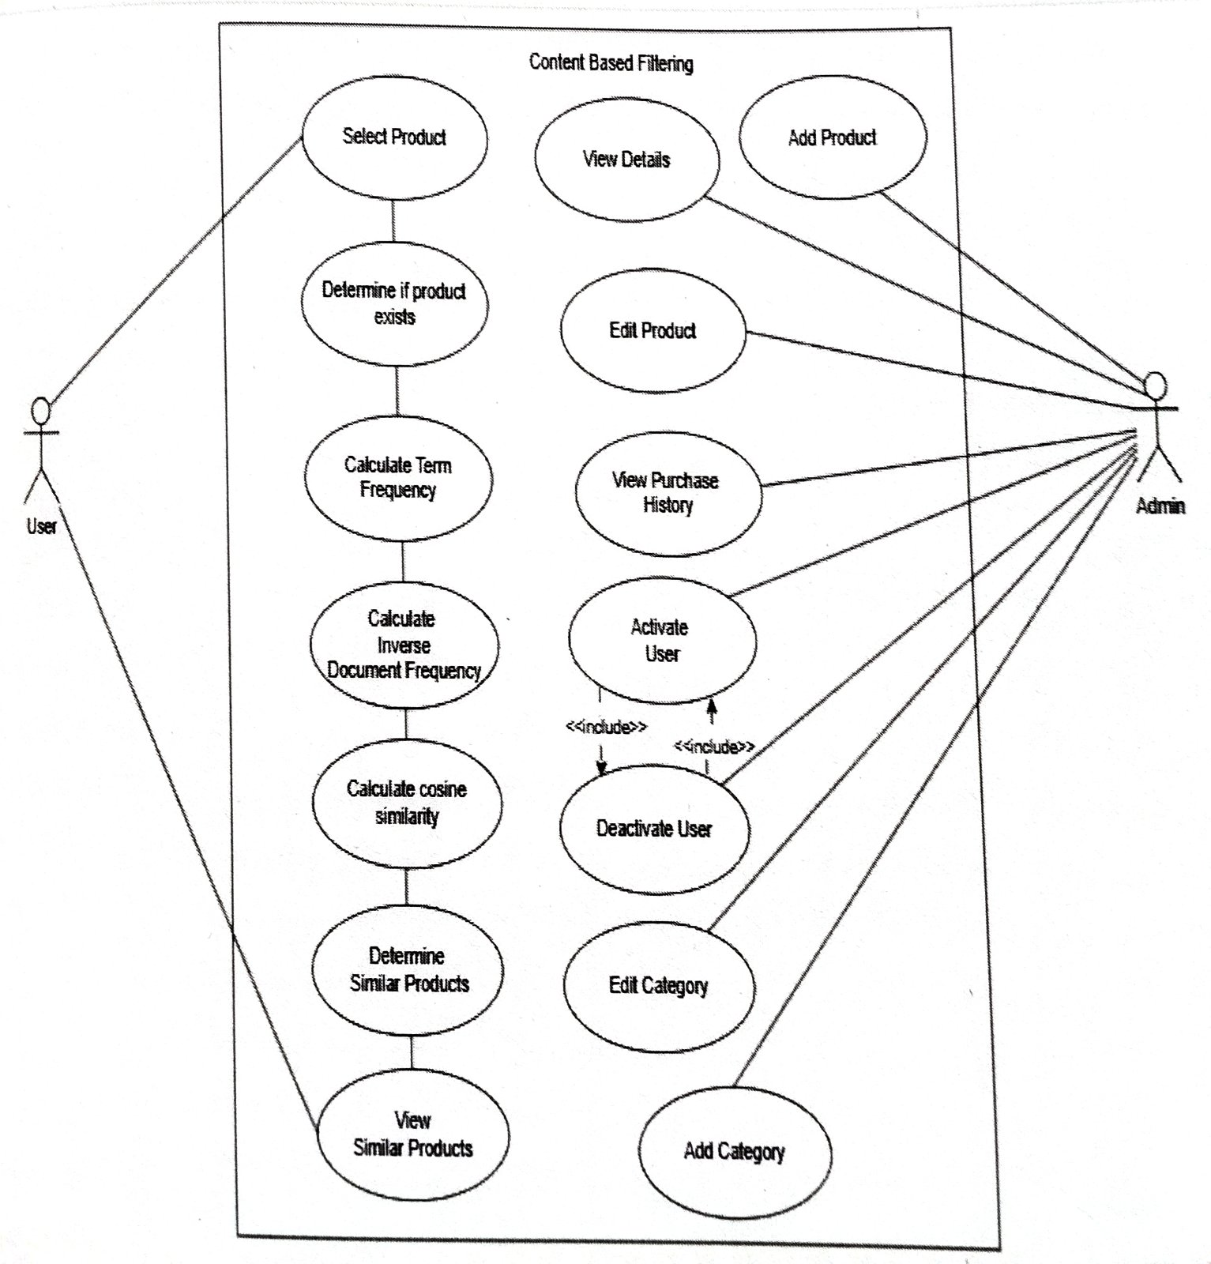
USE
CASE
Diagram
8

Slide 9
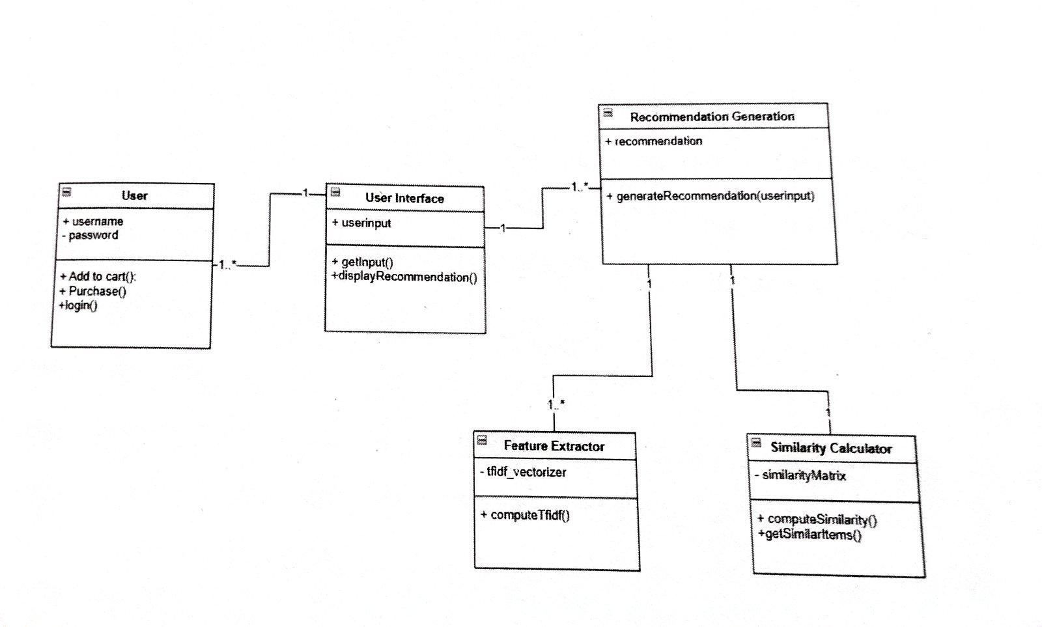
CLASS
DIAGRAM
8

Slide 10
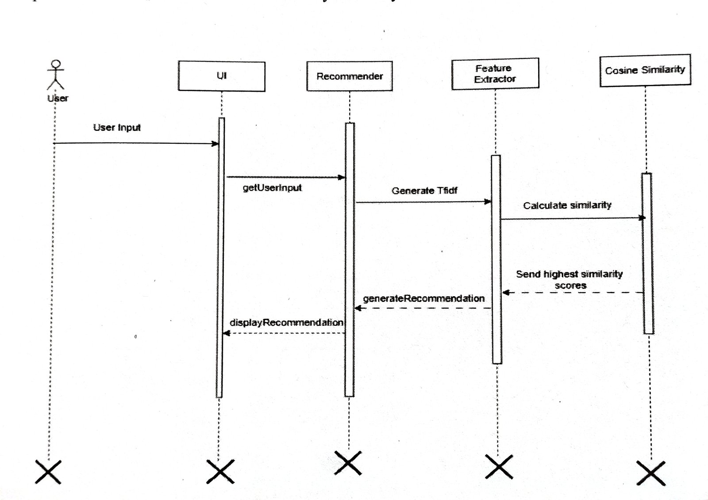
SEQUENCE DIAGRAM

Slide 11
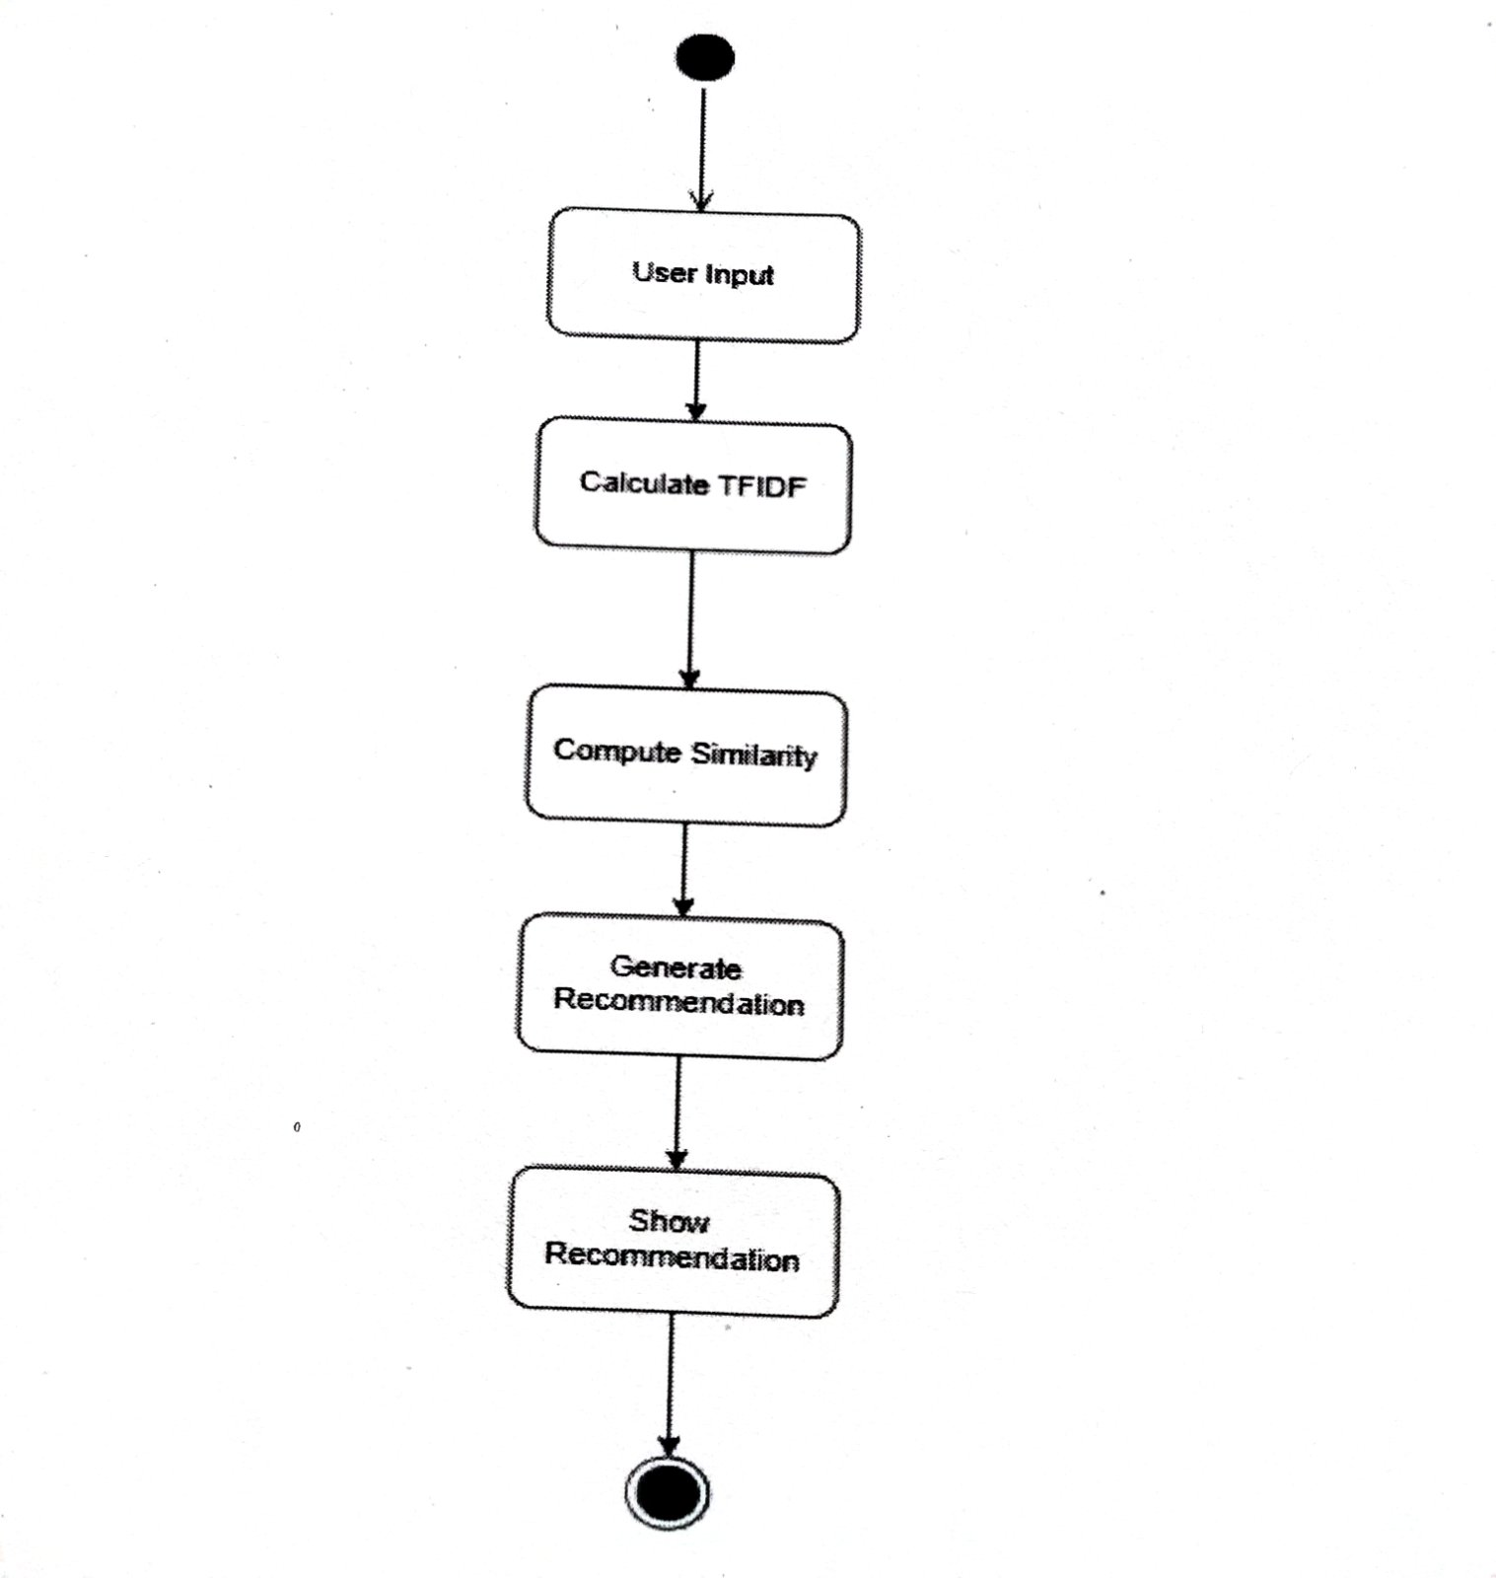
ACTIVITY DIAGRAM

Slide 12
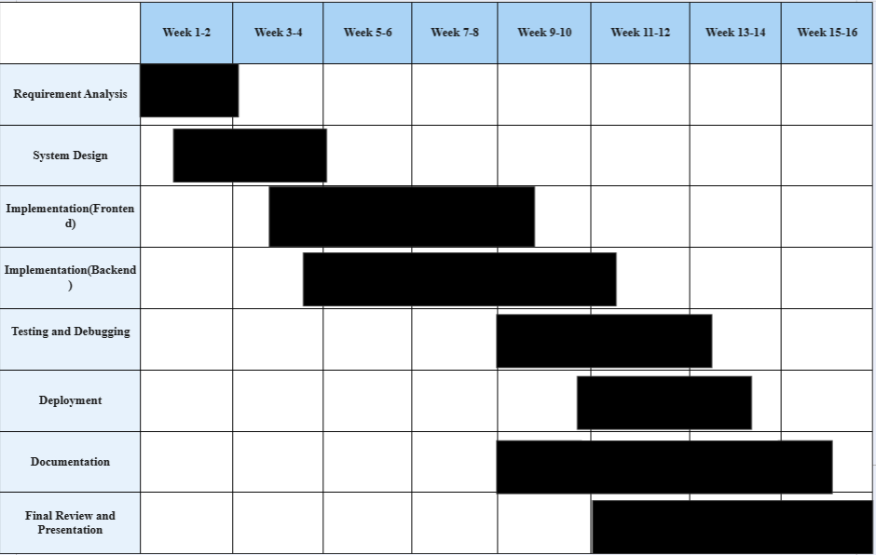

Gantt Chart
9

Slide 13
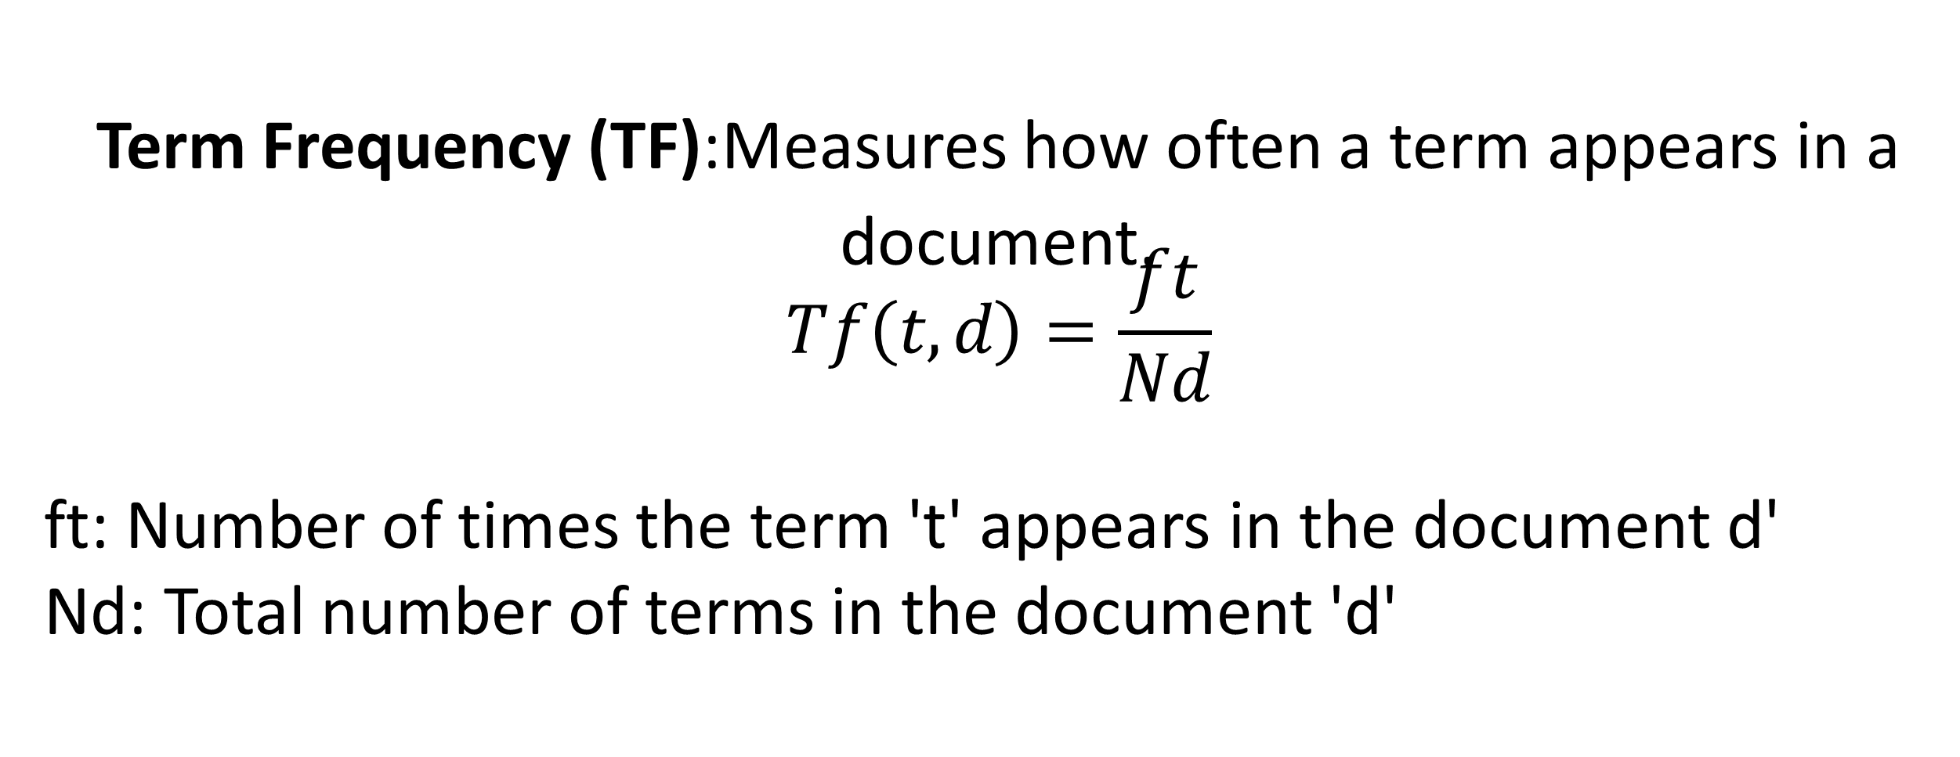
Algorithm Implemented
TF-IDF
Term Frequency (TF):Measures how often a term appears in a document.
$$Tf\left(t,d\right)=\frac{ft}{Nd}$$
ft: Number of times the term 't' appears in the document d'
Nd: Total number of terms in the document 'd'
11

Slide 14
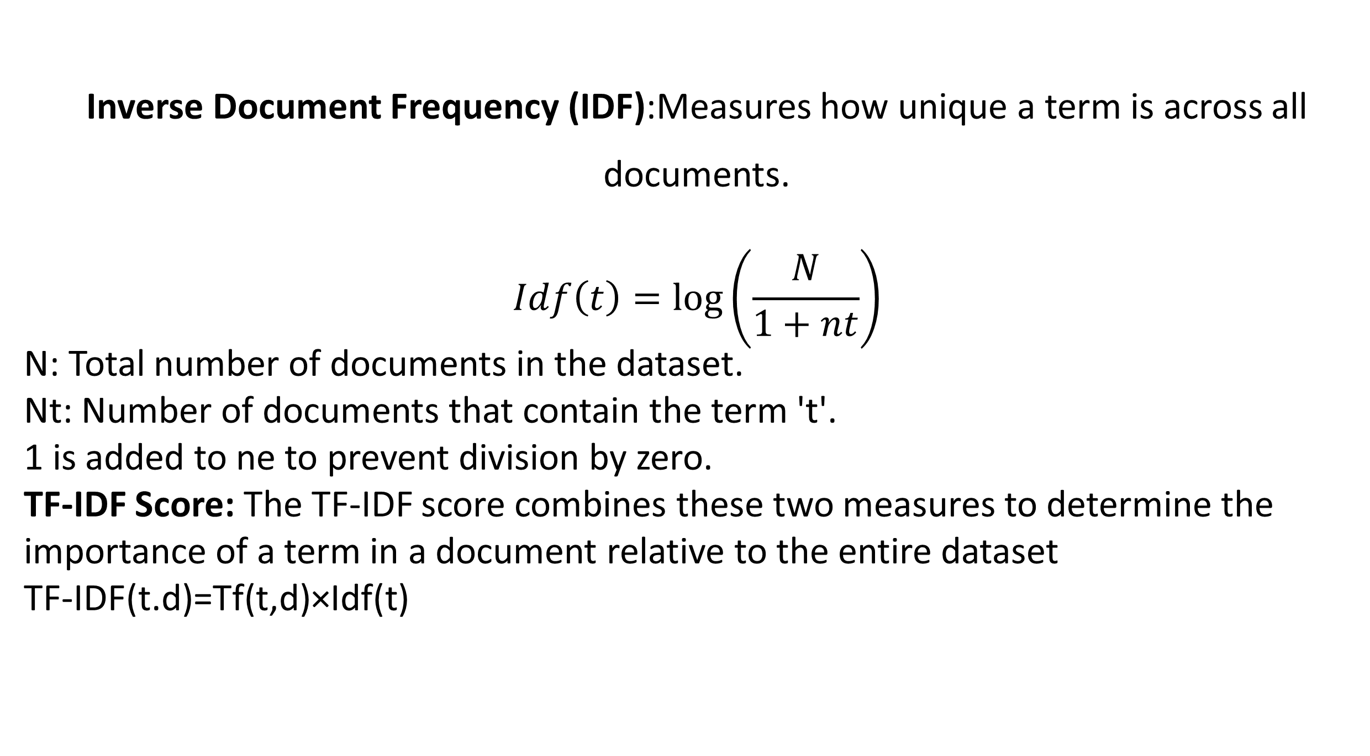
Algorithm Implemented
TF-IDF
Inverse Document Frequency (IDF):Measures how unique a term is across all documents.
$$Idf\left(t\right)=\log\left(\frac{N}{1+nt}\right)$$
N: Total number of documents in the dataset.
Nt: Number of documents that contain the term 't'.
1 is added to ne to prevent division by zero.
TF-IDF Score: The TF-IDF score combines these two measures to determine the importance of a term in a document relative to the entire dataset
TF-IDF(t.d)=Tf(t,d)×Idf(t)
11

Slide 15
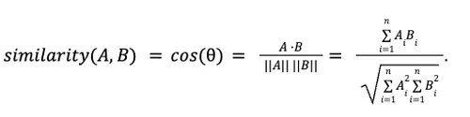
Algorithm Implemented
Cosine Similarity
Purpose: Measures similarity between two items based on their attribute vectors.
Product Representation: Each product is a vector of features (e.g., "sports", "shoes", "running").
Interpretation: Value ranges from -1 to 1; closer to 1 means more similar.
How It Works: Calculates the cosine of the angle between two vectors.
Why Use It: Recommends products with similar features, even if not identical (e.g., different color but same type).
.
10

Slide 16
Algorithm Implemented
Content Based Recommendation
The content based recommendations function generates item recommendations based on content similarity. It first checks if the given tem name exists in the dataset. Then it computes the TF-IDF matrix for the dataset and calculates cosine similarity between the given item's TF-IDF vector and all other items vectors. The function returns the top n most similar items (default 10), sorted by similarity, and includes product details like ID, Name, Description for the recommended items.
10

Slide 17
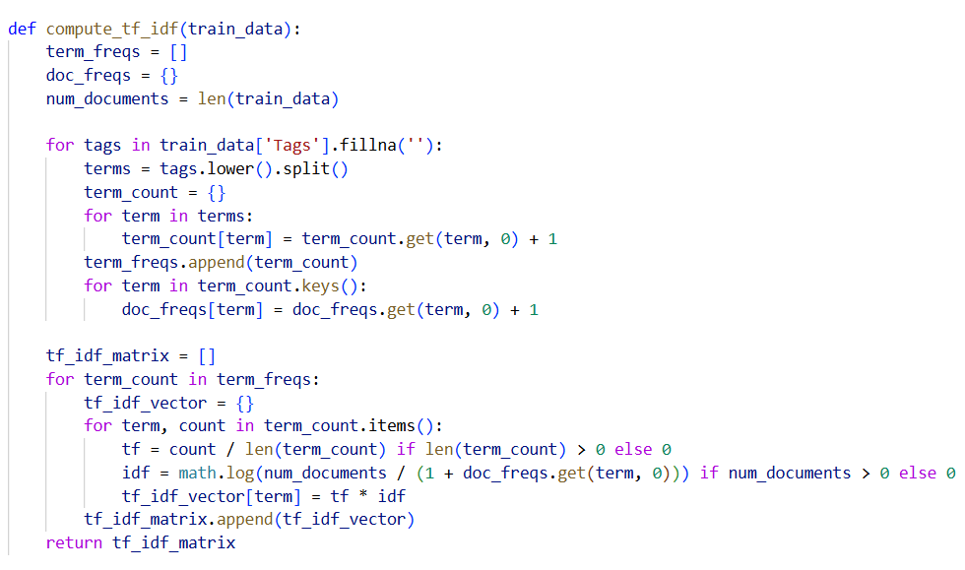

Slide 18
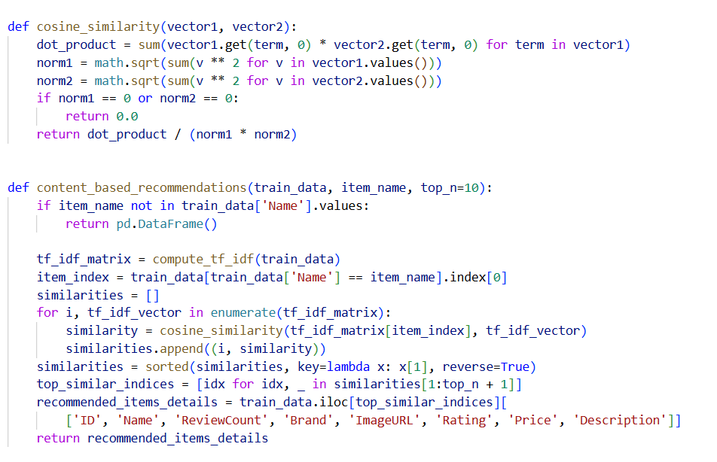

Slide 19
Outcome
1 | A robust, responsive, and secure web application focused on sports accessories.
2 | Functionality to buy, sell, and manage sports-related items.
3 | A built-in recommendation engine that enhances user experience by offering intelligent, relevant product suggestions.
4 | A well-structured database system with clean and scalable code architecture.
5 | Enhanced understanding of full-stack development, CRUD operations, machine learning basics, and deployment.
12

Slide 20
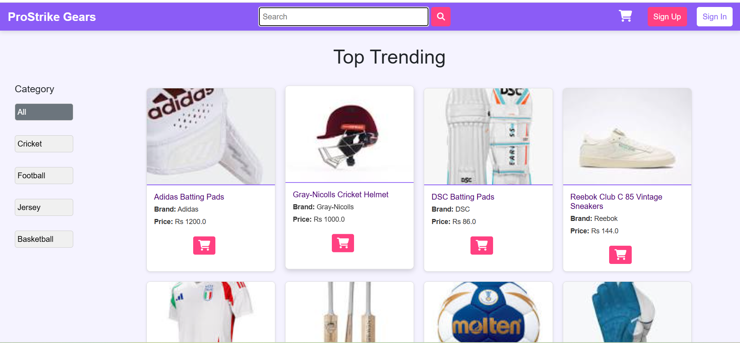
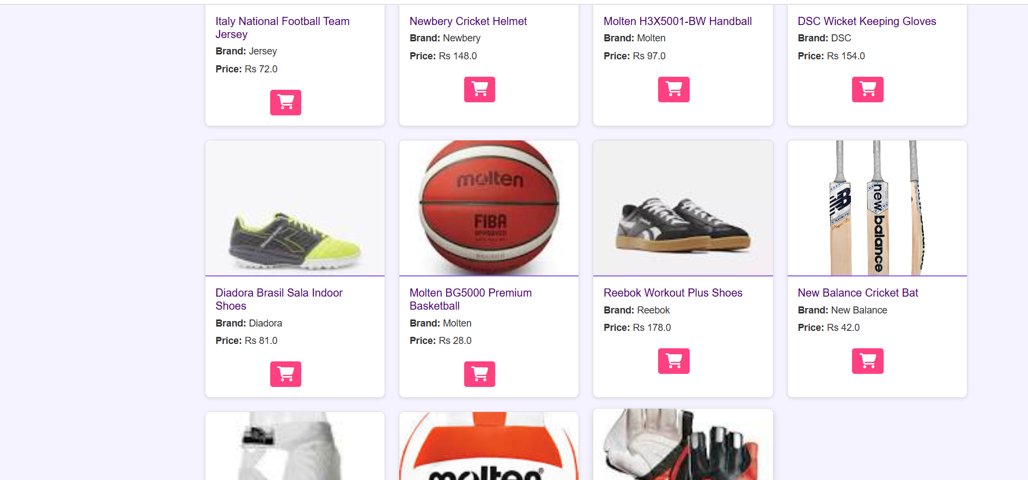
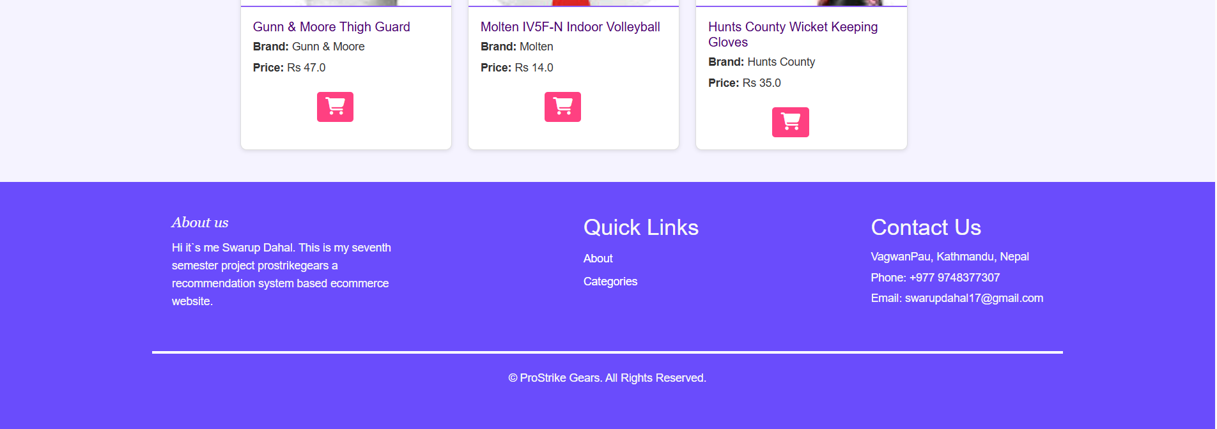
OUTPUT/WEBSIT SNIPPETS

Slide 21
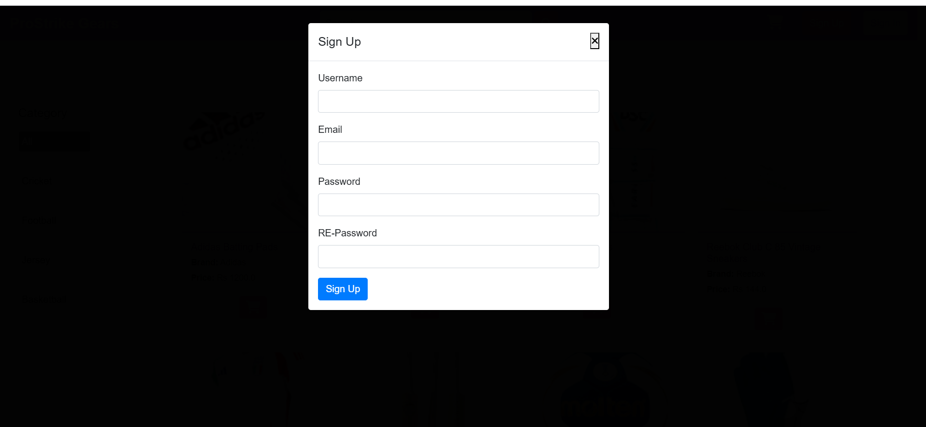
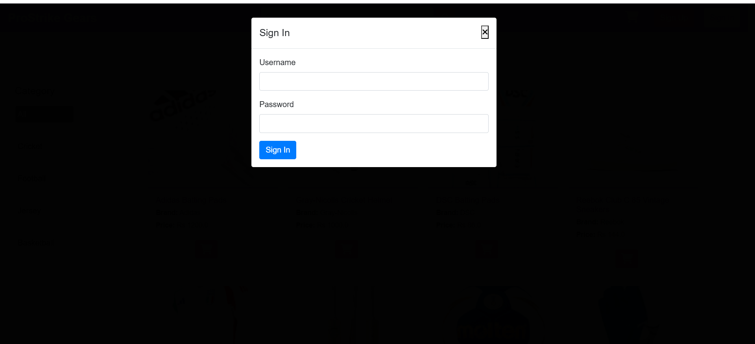
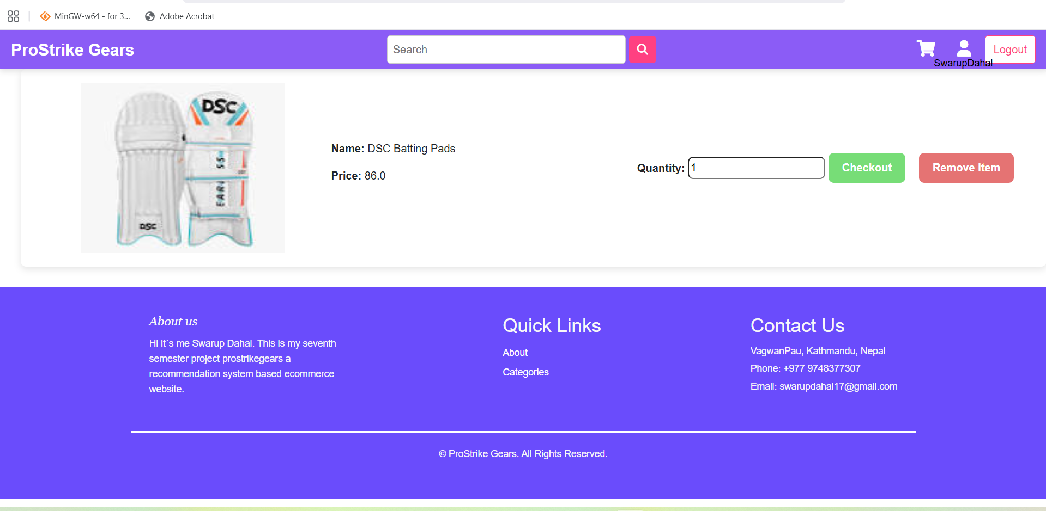

Slide 22
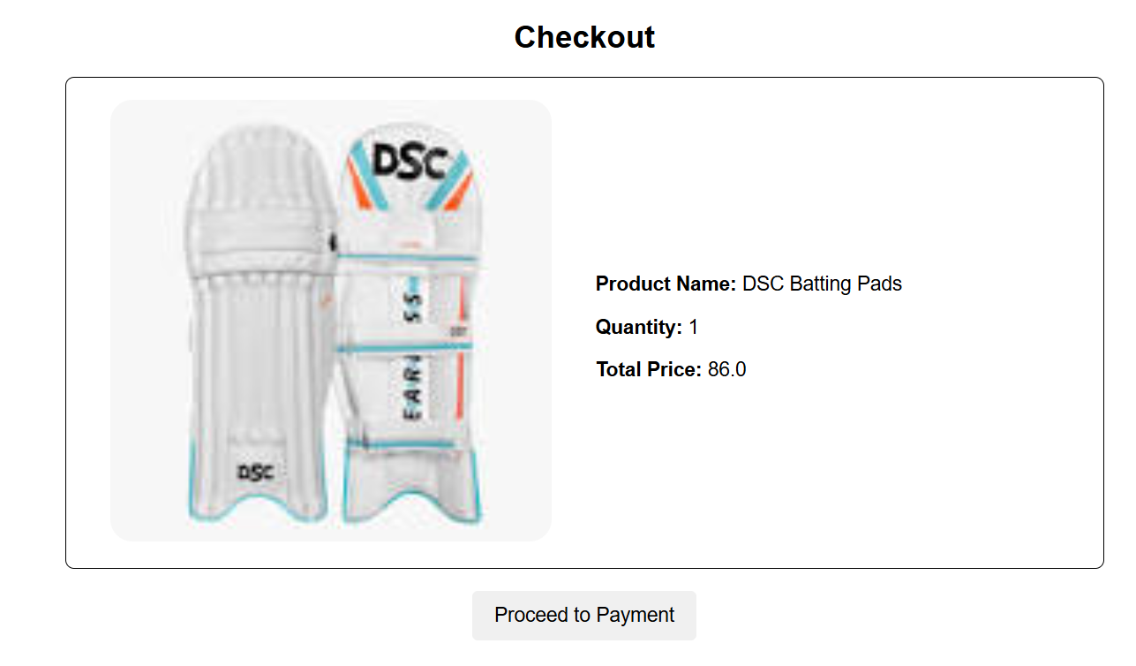

Slide 23
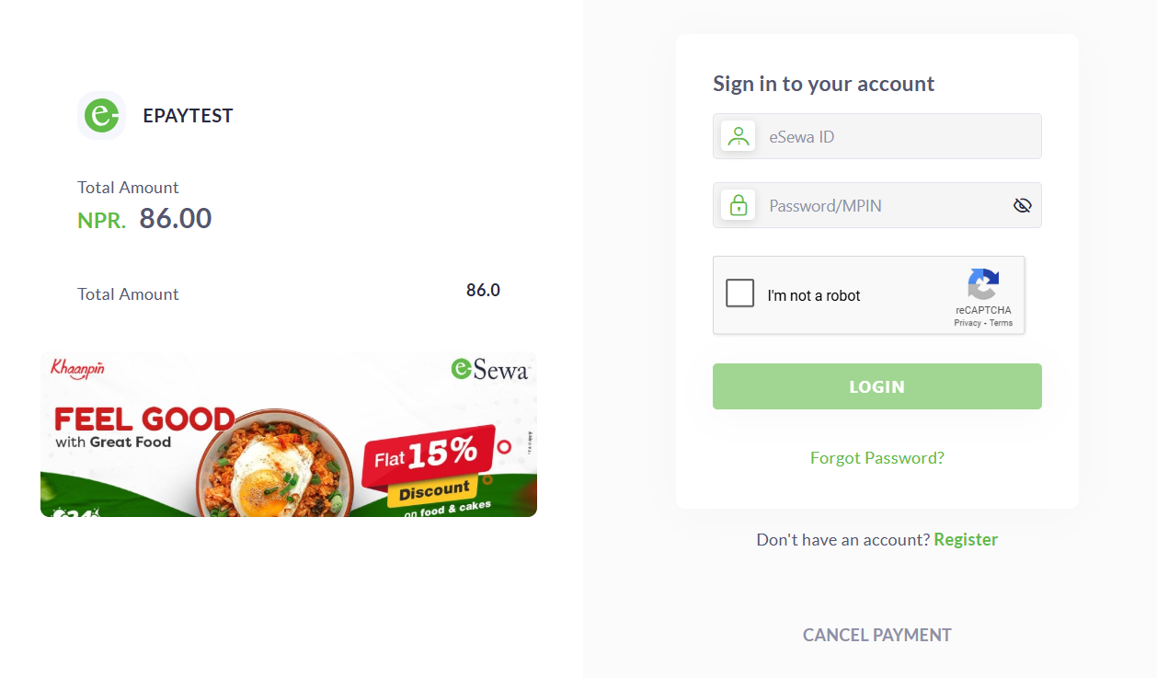
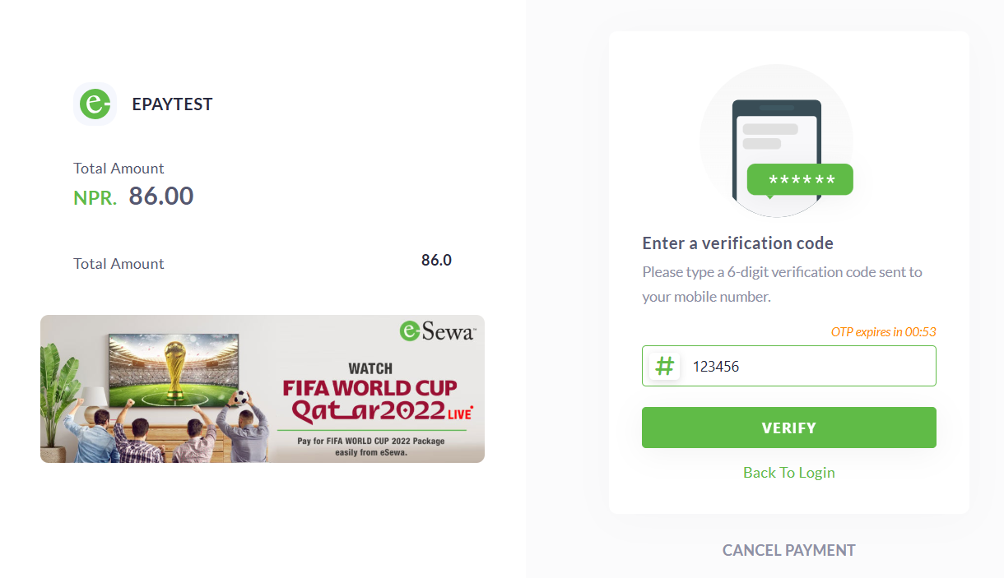
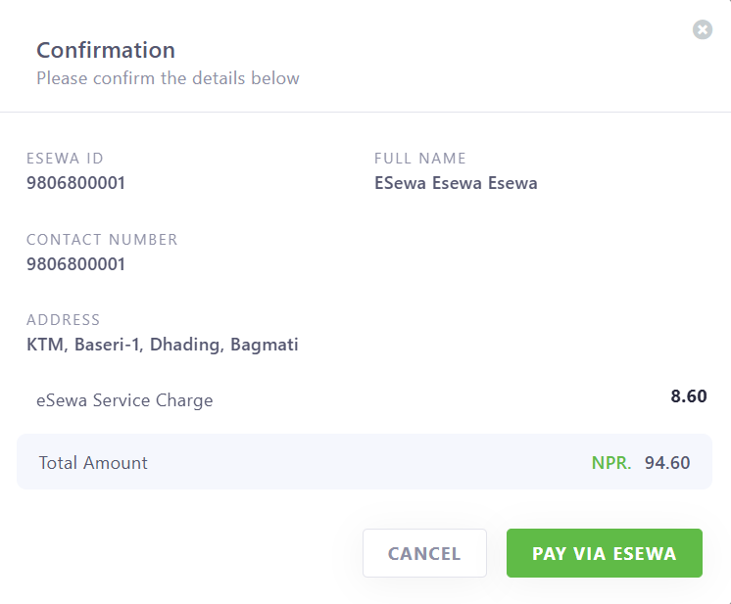
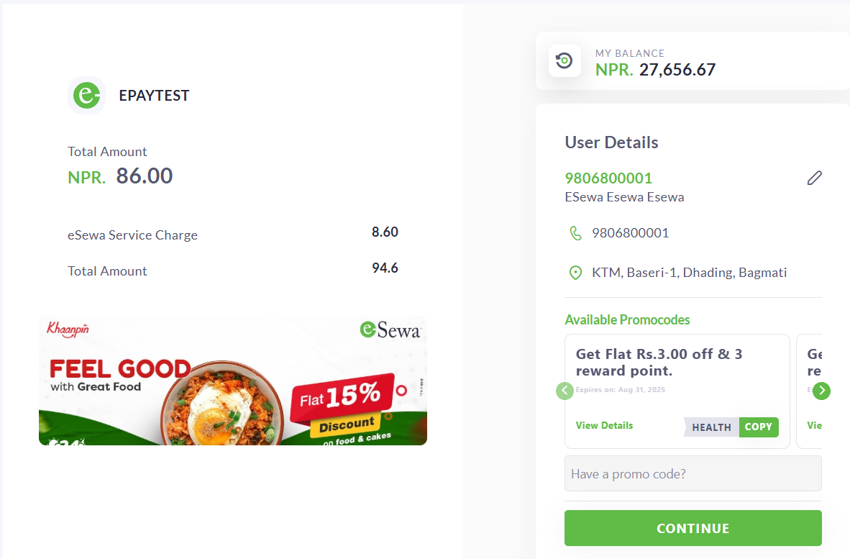

Slide 24
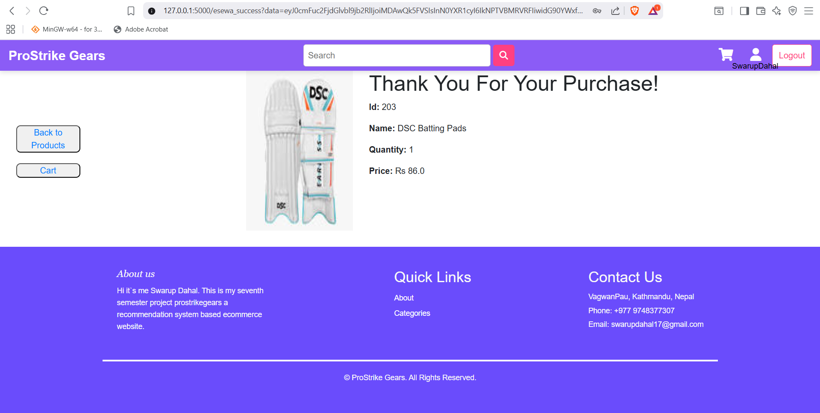
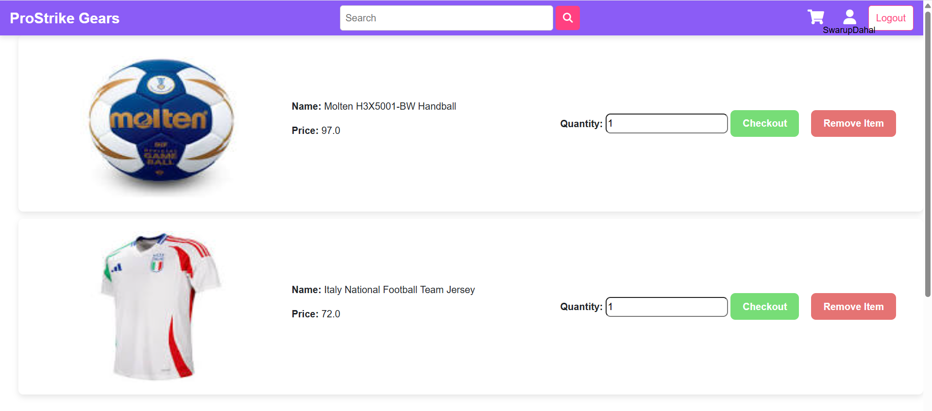
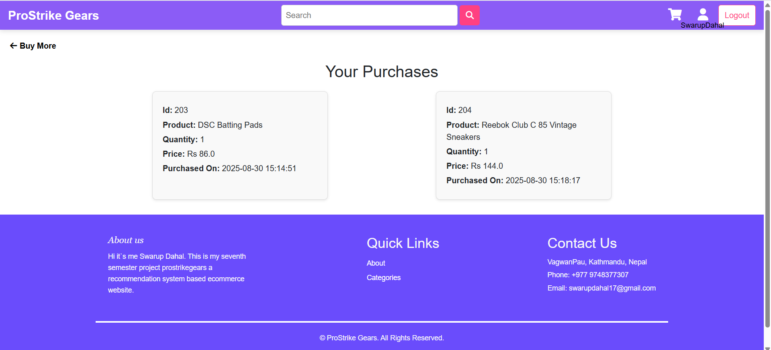

Slide 25
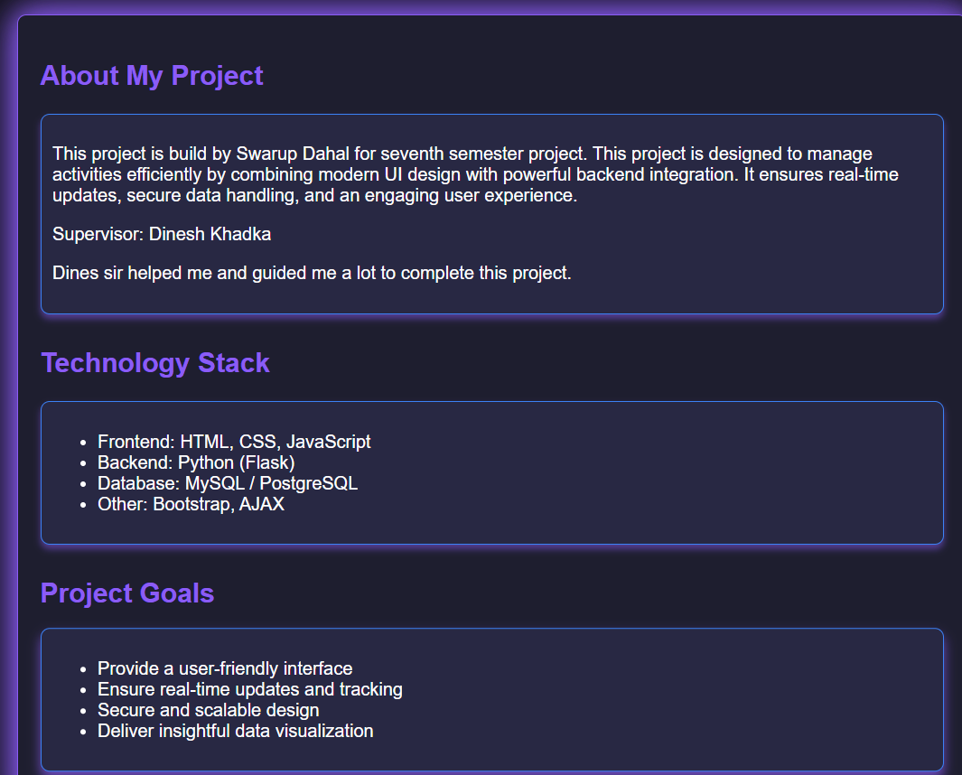

Slide 26
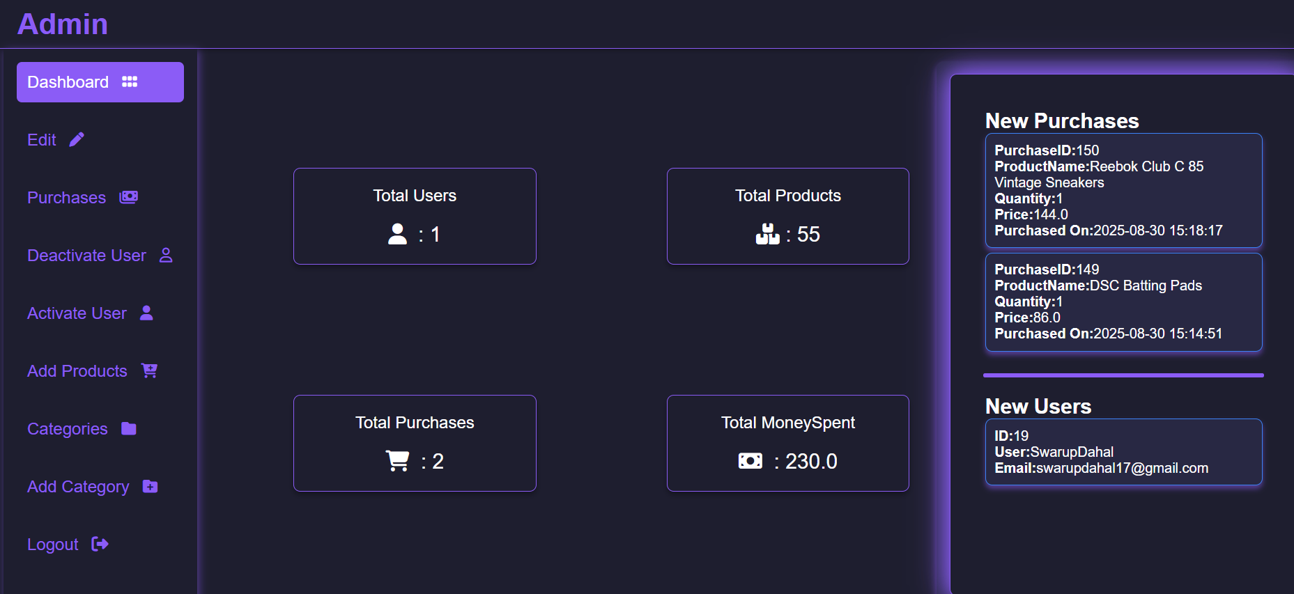

Slide 27
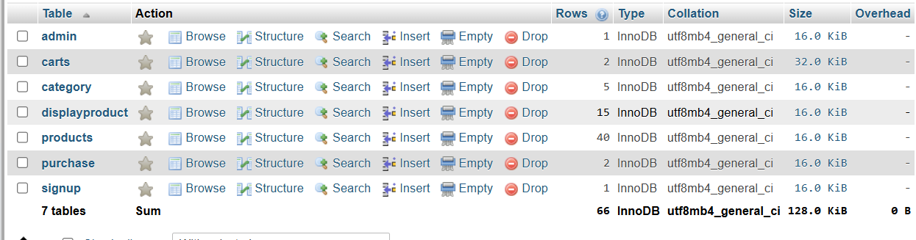

Slide 28
Conclusion
Sports lovers often struggle to find what they need on regular shopping sites.
The suggestions feel off, and browsing can be frustrating.
Using tf-idf and cosine similarity, the platform can recommend gear that actually matches what users like.
In the end, it’s all about making shopping simple, personal, and enjoyable for every sports enthusiast.
13

Slide 29
References
"https://www.projectpro.io/article/sports-analytics-projects-ideas-and-examples/630," Zealous System, 2024.
"bigcommerce.com," 5 May 2023. [Online]. Available: https://www.bigcommerce.com/articles/ecommerce/recommendation-engine/.
A. S. N. Da’u, "Recommendation system based on deep learning methods: a systematic review and new directions," Artificial Intelligence Review, vol. 53, no. 4, pp. 2709-2748, 2020.
14

